Slide 1

COMPANY PROFILE
Makole international is a holding company with interest in the Energy Sector, Information Technology, and Financial Services.
Makole International is a 100% black owned diverse African Investment Holding Company. It was formed by Mr Tshepo Bokaba who is a Chairman of the group.
BUSINESS INFORMATION:
Business Name: Makole International
Business Address: 28 Vungu Street
Moreleta Park
South Africa
Email: tshepo@makoleinternational.com,
info@makoleinternational.com
wwww.makoleinternational.com
Tel: +27 74 848 9028
Telefax: +27 86 767 5327

Slide 2

EXECUTIVE SUMMARY
Makole International is multifaceted holding company. It was formed three years ago, and at that stage it had only one company under its holding. It has now added two more companies and will continue to add either by acquisition or organic growth.
Following is a brief description of each business units and their activities.

Slide 3

MAKOLE PRIVATE EQUITY (PTY) LTD
REG. 2015-033041-07
CSD - MAAA0392897
FINACIAL SERVICES
Makole Private Equity is an investment company with interests is unlisted private companies.
We have 40 percent interest in Arkein General Partners, we use this link to raise our acquisition funding. We have to date raised up R1bn for sub-Saharan African countries acquisition, hence the strategy for Makole Private Equity to start funding into the Defence industry.

Slide 4

FINACIAL SERVICES
MAKOLE CAPITAL (PTY) LTD
REG. 2015-030145-07
CSD - MAAA0392943
Makole Capital is an investment company with a
focused pipeline of listed entities
INFORMATION TECHNOLOGU SERVICES
MAKOLE TECHNOLOGY SERVICES
REG: 2022/644600/07
CSD: MAAA1245158
We offer the following services
ERP Resources and implementation
ICT – Project Management and Project Scoping Resources
ICT – Networks , ICT Security Implementation
ICT Software solutions and BI Business Intelligence

Slide 5

ENERGY SECTOR
NEMBE HOLDING (PTY) LTD
REG. 2010-012946-07
CSD - MAAA0392980
Nembe Holdings is a 100 percent black owned and managed mining operations company. We specialize in shaft construction, vamping, and development drilling and underground railroad construction. We also supply Petroleum fuel and Lubricants (Grease)
We also provide a wide range of Personal Protective Equipment:
Our PPE is categorized as follows:
Eye protection (glasses, goggles, face shields)
Hearing protection (ear plugs, earmuffs)
Respiratory protection (dust mask filters)
Head protection (hard hats, helmets, bump caps)
Hand protection (gloves)
Skin protection (full length clothing)
Foot protection (steel toe caps, metatarsal)

Slide 6
MAKOLE INTERNATIONAL STRATEGY
Purpose:
To be a leader of 100 percent owned and managed, diversified companies.
Vision:
To provide quality service that exceeds the expectation of our esteemed customers.
Mission Statement:
To build long term relationships with our customers and provide exceptional customer service by pursuing business through innovation and advanced technology.
Core Values:
We believe in treating our customers with respect and faith. We integrate honesty, integrity and business ethics into all our aspects of business functioning.
Goals:
Expansion and Growth in all areas of our involvement.

Slide 7






Our Partners

Slide 8
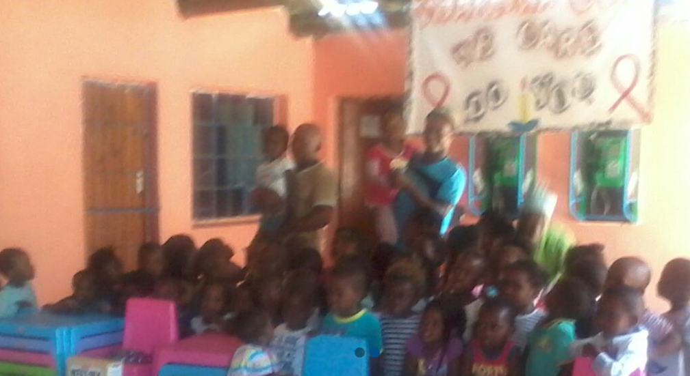
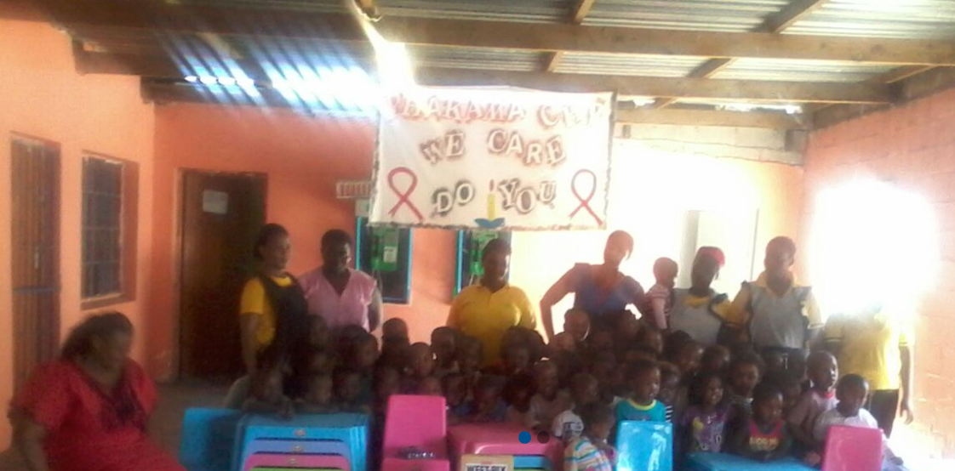
CORPORATE SOCIAL RESPONSIBILITY
Making real our commitment as a responsible corporate person.
Nyanga Sunrise’s commitment to honouring our shared human values inspires the unparalleled support we receive from our community. With the support of the community-based project Mzansi, the sun rose on our dream and Sunrise Services was born, opening doors for young people and creating a community network with Phakama Community Health Centre which delivers meals for the unemployed and fostering life skills. Sunrise Services also assists in donating materials and resources to a very poor, local private school.

